Slide 1



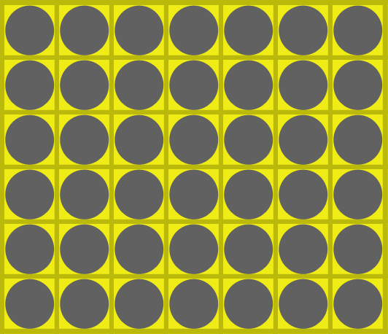
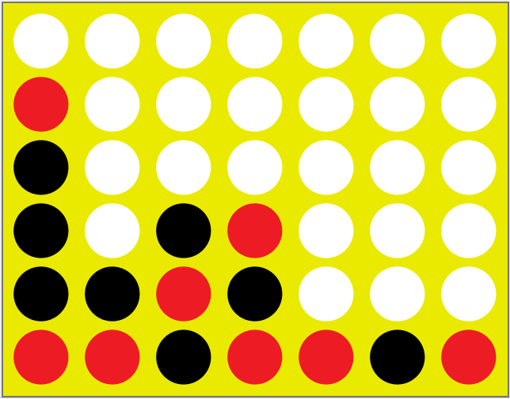
Applied System Software
Mohammed Arham Mohammed 221ADB053
Furqan Ul Islam 211ADB086

Slide 2
Contents of this template
Gaol | To discuss the goal of our task.
PEAS Description | PEAS (Performance measures, Environment, Actuators, and Sensors) of our task.
Rules of the game | Basic rules of the connect 4 game.
Game Complexity | Dsicusing Complexity of the game.
Interface Overview | Discusing interface of the game.
Conlusion | Conclusion along with refences used.

Slide 3
Goal
The goal of this task was to create an agent to play the game Connect Four. The rules for the game were taken from the classic game of Connect Four. However, the environment and the agent program was created from scratch. On the surface the program functions as a simple Connect Four game playable between two human players. In order to make an appropriate agent design, the task environment must first be identified and described.
We have used PEAS (Performance measures, Environment, Actuators, and Sensors) description concept to describe this task environment. The task environment can be further categorized by several other factors, such as observability, number of agents, etc.

Slide 4
PEAS Description
Agent Type | Connect Four Playing Software Agent
1. Performance Measure | Put four pieces adjacent or diagonal to each other, prevent opponent from doing the same.
2. Environment | Game Board, Agent’s pieces, and Opponent’s pieces.
3. Acutators | Piece placing function.
4. Sensors | Direct access of the state board

Slide 5

Rules of the game
Connect-Four is a game for two persons. Both players have 21 identical pieces. In the standard form of the game, one set of pieces is red and the other set is yellow. The game is played on a vertical, rectangular board consisting of 7 vertical columns of 6 squares each. If one piece is put in one of the columns, it will fall down to the lowest unoccupied square in the column. As soon as a column contains 6 pieces, no other piece can be put in the column. Putting a piece in one of the columns is called a move.

Slide 6

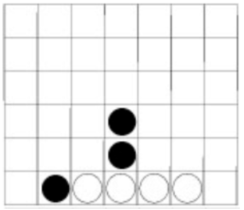
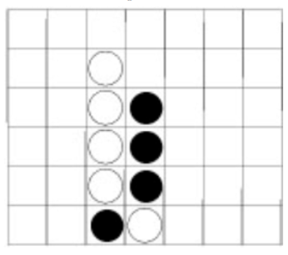
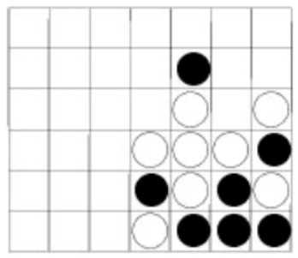
Rules of the game
The players make their moves in turn. There are no rules stating that the player with, for instance, the red pieces should start. Since it is confusing to identify for each new game the color that started the game, we will assume that the sets of pieces are colored white and black instead of red and yellow. Like chess and checkers (and unlike go) it is assumed that the player playing the white pieces will make the first move.
Figure 1
Figure 2
Figure 2

Slide 7
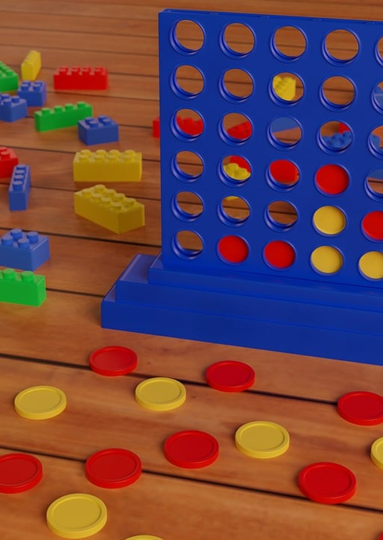
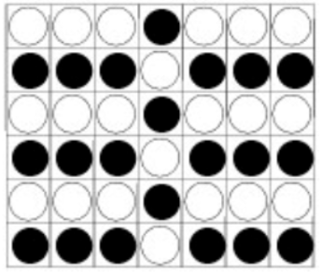
Rules of the game
Both Players will try to get four connected pieces, horizontally, vertically or diagonally. The first player who achieves one such group of four connected pieces wins the game. If all 42 pieces are played and no player has achieved this goal, the game is a draw.
A possible drawn position:

Slide 8
Game Complexity
Legal vs. Illegal Positions: Legal positions are those that can occur during a game following the rules, while illegal positions cannot.
State of Each Square: On a Connect-Four board, each of the 42 squares can be empty, occupied by a red piece, or occupied by a black piece.
Total Possible Positions: Considering all possible configurations, the number of potential positions is at most 3⁴², which is approximately 10²⁰.
Reduction of Upper Bound: By incorporating the rules of Connect-Four, such as player turns and win conditions, the upper bound on the 7x6 board reduces to 7.1×10¹³.

Slide 9
Game Features
Player Selection: Players can choose to play against either a human player or a computer player. The selection is made via a user-friendly GUI with radio buttons.
Visual Game Board: The game board is visually displayed with a 7x6 grid layout. Players can easily see the current state of the game, including the positions of all discs. Players take turns dropping colored discs into the columns of the grid. The discs fall to the lowest available slot within the selected column.
Win Detection: The game automatically detects when a player has connected four discs in a row horizontally, vertically, or diagonally. The game announces the winner immediately upon detection of a winning condition. Similarly, if the board fills up and no player has four discs in a row, the game is declared draw and a message is displayed indicating the tie.

Slide 10
Game Features
Game Option: Players have the option to restart the current game at any time. The game board is reset, and players can start a new game with the same settings. Players can also start a completely new game, allowing for opponent type selection. The game initializes a fresh state.
AI: When playing against the computer, an AI opponent makes moves according to predefined strategies. The AI provides a challenging experience for single-player games. Our game consist of three AI players. 1. Random AI(Easy) 2.Defensive AI(Moderate) 3. Minimax AI(Hard)

Slide 11
Opponent AI
Random AI: The Easy AI player for Connect 4 is a basic opponent that chooses its moves randomly. It ensures that moves are valid by avoiding full columns, but otherwise does not engage in any strategic planning or foresight. This makes it an accessible and straightforward opponent for players, especially beginners, providing a fundamental challenge without complexity.
Defensive AI: The Moderate AI player enhances gameplay difficulty by actively scanning the board for threats posed by the opponent and prioritizing moves that block these threats. By evaluating potential winning conditions for the opponent and assigning threat levels to each column, this AI makes more informed decisions aimed at preventing the opponent from connecting four discs. This defensive strategy creates a more engaging and challenging experience for players compared to the random moves of the Easy AI.

Slide 12
Opponent AI
Minimax AI: The Hard player uses the Minimax algorithm to choose moves that maximize its advantage while minimizing the opponent's potential to win. By evaluating the game tree up to a specified depth and using a heuristic utility function, the player can make strategic decisions that are difficult for simpler AI opponents to counter. The depth-limited search ensures the algorithm remains computationally feasible, allowing the player to make decisions in a reasonable amount of time.
.

Slide 13
Interface Overview
Two-Part Interface:
Menu: Provides access to various game controls, settings, and player management options.
Game Board: The visual representation of the Connect-Four board where the game is played.
Menu Functions:
Game Controls: Start new games, restart current games, or quit the game.
AI Algorithm Selection: Choose which AI algorithm will control the AI players.
Player Configuration: Designate each player as either a human or an AI agent.
Switching Players:
Dynamic Switching: Allows users to switch between human and AI players at any point during the game.
Testing Scenarios: Useful for observing how AI responds to different board configurations set up by human players.
Initial Configuration:
Starting Position: The game begins with an empty board with 42 empty squares.
Turn-Based Play: Players take alternating turns to drop pieces into one of the seven columns.
User Interaction:
Move Execution: Human players make their moves by clicking the button above the desired column, which then drops a piece into the column.
Real-Life Simulation: This button-based interaction mirrors the real-life gameplay of Connect-Four, where pieces are dropped from the top of the board.

Slide 14
GUI
Libraries: For creating GUI we used libraries: javax.swing.*, java.awt.* java.awt.event.*
javax.swing.*:
Frame: A top-level container used to create a window.
JPanel: A generic lightweight container.
JLayeredPane: A container that can hold multiple components with specific depth values.
JMenuBar, JMenu, JMenuItem, JRadioButtonMenuItem: Components to create menus and menu items.
JLabel: A component that displays a short string or an image icon.
JButton: A button that can trigger an action when clicked.
java.awt.*:
Dimension: A class encapsulating the width and height of a component.
BorderLayout, GridLayout: Layout managers that control the size and position of components.
Component: An abstract base class for all AWT components.
ImageIcon: An implementation of the Icon interface that paints icons from images.
java.awt.event.*:
ActionListener, ItemListener: Interfaces for receiving action and item events.
ActionEvent, ItemEvent: Event classes for actions performed by the user.
WindowAdapter, WindowEvent: Used for receiving window events.

Slide 15
Testing
We used JUnit framework for testing our software. JUnit provides a simple and effective way to write and run repeatable tests. It is an open-source framework, primarily used to test the individual units of source code, ensuring that each unit performs as expected.
We have used ‘@Test’ annotation to identify methods that contain tests and other important information. This annotations particularly marks a method as a test method.
JUnit provides a set of assertion methods to check expected results against actual results. Assert statements that we used fir testing our software:
assertEquals(expected, actual): Checks if two values are equal.
assertTrue(condition): Checks if a condition is true.
assertFalse(condition): Checks if a condition is false.

Slide 16
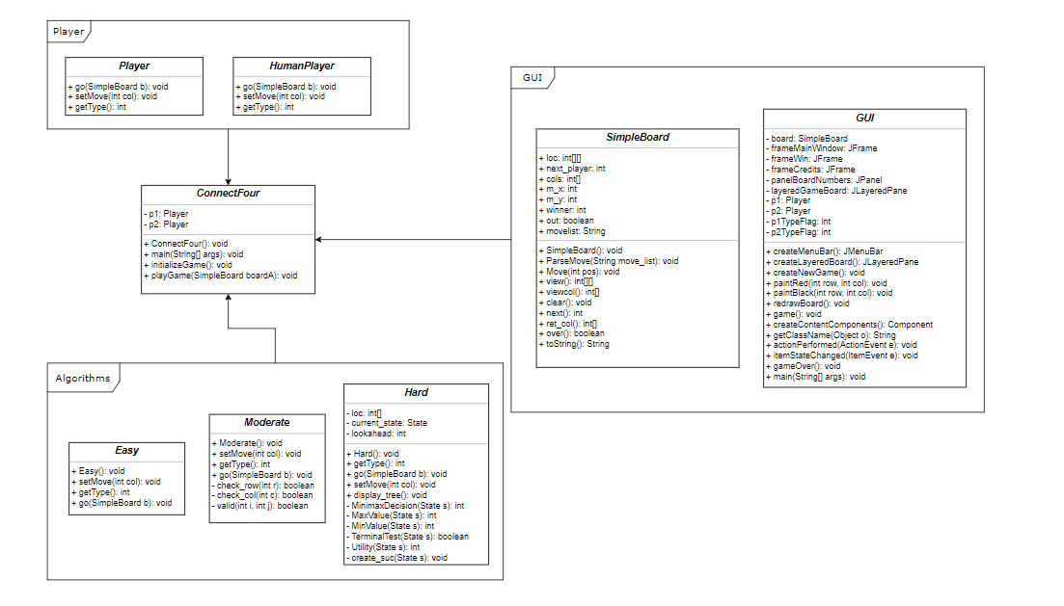

Slide 17
Conclusion
The most experience was gained in computer game-playing agent design.
The ideal algorithm for success may be beyond current technological capabilities.
Alternative algorithms can still create an engaging playing experience.
A crucial game design concept is that players prefer games where they have a chance to win.
A perfect algorithm that always wins could reduce human interest in the game.
The main task of the project was to create comprehensive documentation.
The documentation included requirements, software design, and testing documents.
These formal documents were essential for a structured and thorough development process.
The documentation facilitated effective communication and project management.

Slide 18
Thank You
References:
https://0xadada.pub/2003/12/15/connect-four-playing-ai-agent/
https://github.com/0xadada/smart-connect-four

